Slide 1

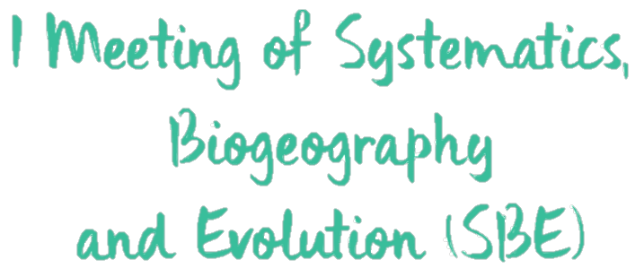

Using deep learning for unifying genomic data and traits in species delimitation
@ManoloFPerez
sites.google.com/site/manolofperez
MF Perez; I Sanmartín; BC Faircloth; LAC Bertollo; MB Cioffi

Slide 2
Introduction
Different species concepts - distinct strategies to identify species boundaries (de Queiroz 2007). It is important to adopt a multidisciplinary approach, by assessing different sources of evidence (Carstens et al. 2013).
Most approaches consist in analyzing genomic and phenotypical/geographical information separately, followed by visual/qualitative comparison. Methods that actually integrate different data are limited to up to a few hundreds of loci and simple models of evolution (Solís-Lemus et al. 2015).
We present a method based on simulated data and deep learning, that combines both genomic and trait information in a unified framework.

Slide 3
Methods

Slide 4
Results
Probabilities are low when using only traits.
Increasing SNPs also raised the probability of recovering the right model.
little improvement with > 50 SNPs.
Using both genomic and trait data recovered slightly better results than using only SNPs.

Slide 5
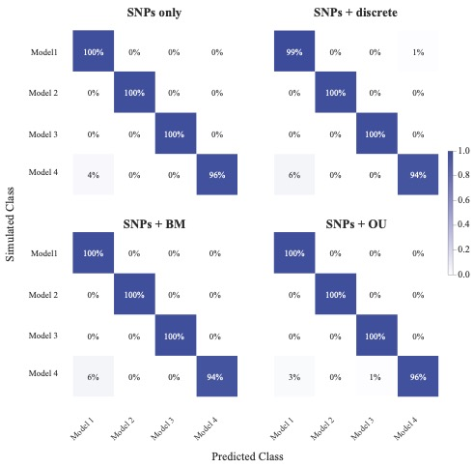
Conclusions
The accuracy of our approach was very high (confusion matrix with the test set). Confusion of model 4 (migration) with model 1 (one species).
Incorporating traits resulted in similar accuracy to using only SNPs.
Traits incorporate information complimentary to genomic datam that might be useful for species delimitation.
1
2
3
4
1
2
3
4

